Slide 1
Dynamic Programming Part 2
CS240 Spring 2023
Rui Fan

Slide 2
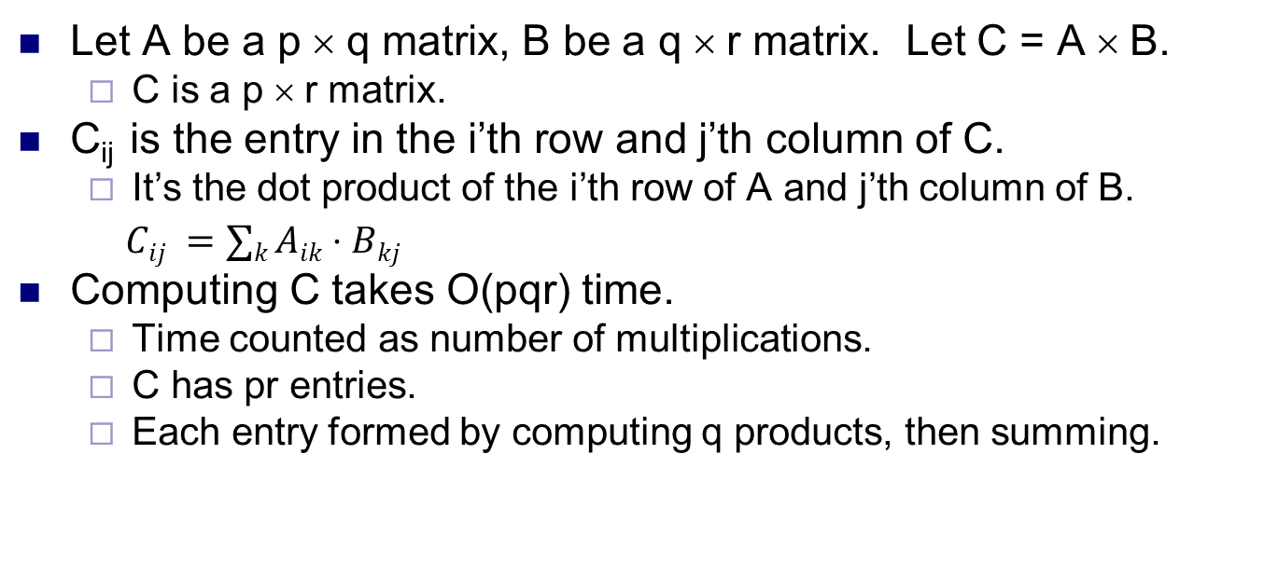
Matrix multiplication
2 | 1 | 0 | 3
1 | 4 | 4 | 2
1 | 2
3 | 4
4 | 3
2 | 1
11 | 11
33 | 32
=
Let A be a p × q matrix, B be a q × r matrix. Let C = A × B.
C is a p × r matrix.
C_{ij} is the entry in the i’th row and j’th column of C.
It’s the dot product of the i’th row of A and j’th column of B.
$Cij =∑k Aik⋅Bkj$
Computing C takes O(pqr) time.
Time counted as number of multiplications.
C has pr entries.
Each entry formed by computing q products, then summing.

Slide 3
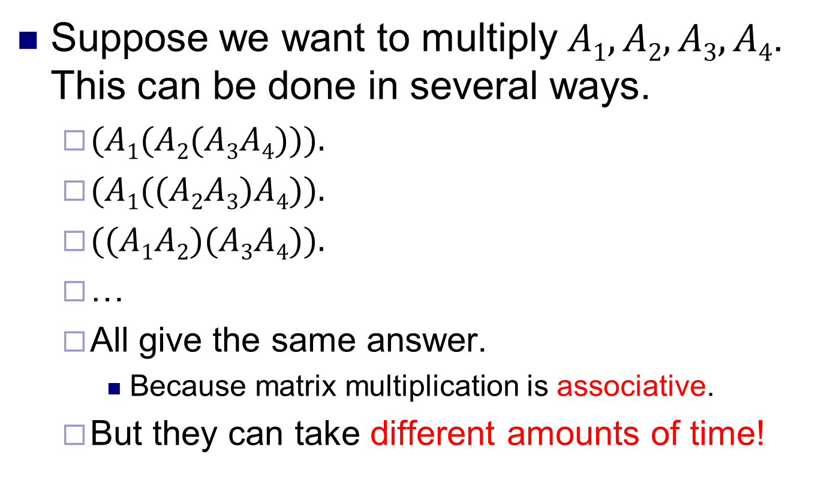
Multiplying many matrices
Suppose we want to multiply $A1,A2,A3,A4$. This can be done in several ways.
$(A1(A2(A3A4))).$
$(A1((A2A3)A4)).$
$((A1A2)(A3A4)).$
…
All give the same answer.
Because matrix multiplication is associative.
But they can take different amounts of time!

Slide 4
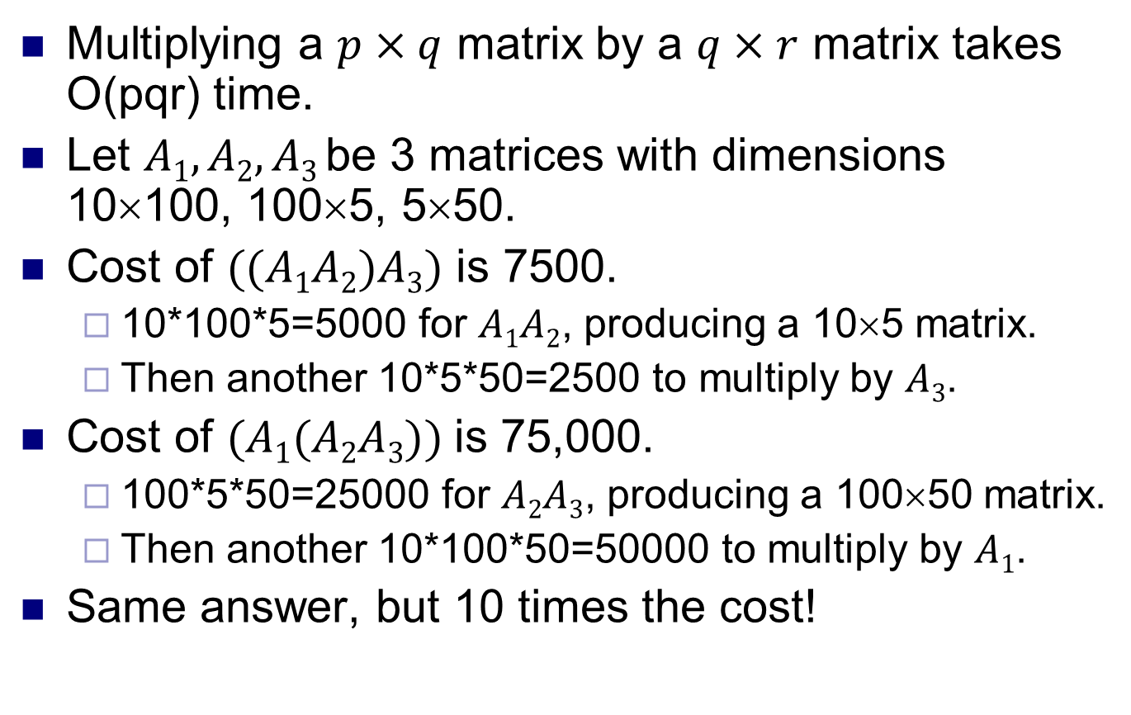
Same answer, different costs
Multiplying a $p×q$ matrix by a $q×r$ matrix takes O(pqr) time.
Let $A1,A2,A3$be 3 matrices with dimensions 10×100, 100×5, 5×50.
Cost of $((A1A2)A3)$ is 7500.
10*100*5=5000 for $A1A2$, producing a 10×5 matrix.
Then another 10*5*50=2500 to multiply by $A3$.
Cost of $(A1(A2A3))$is 75,000.
100*5*50=25000 for $A2A3$, producing a 100×50 matrix.
Then another 10*100*50=50000 to multiply by $A1$.
Same answer, but 10 times the cost!

Slide 5
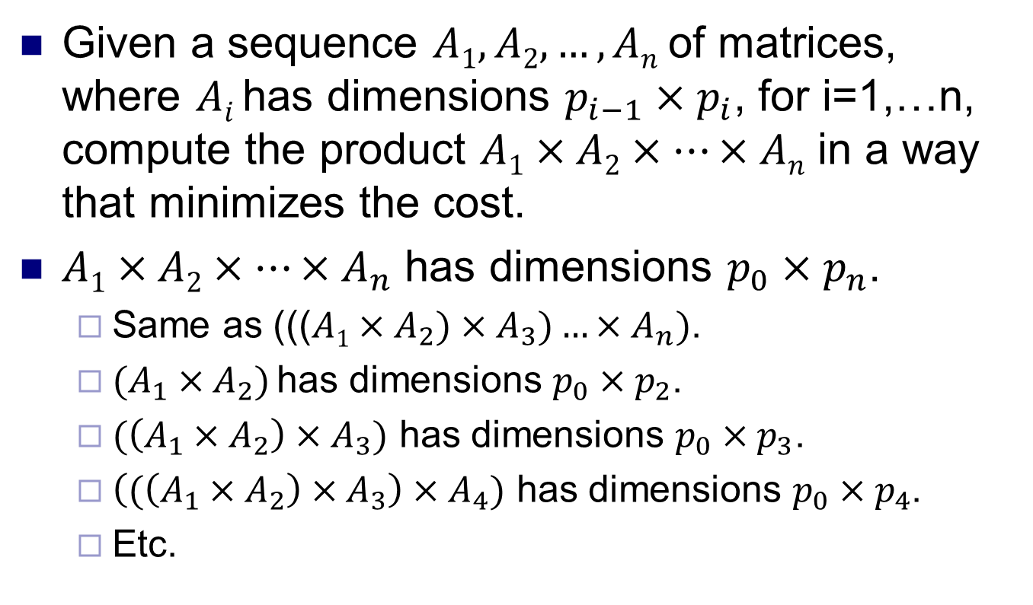
Matrix-chain multiplication problem
Given a sequence $A1,A2,…,An$of matrices, where $Ai$ has dimensions $p_{i−1}×p_{i}$, for i=1,…n, compute the product $A1×A2×…×An$ in a way that minimizes the cost.
$A1×A2×…×A_{n}$ has dimensions $p_{0}×p_{n}$.
Same as ((($A1×A_{2})×A_{3})…×A_{n})$.
$(A_{1}×A_{2})$has dimensions $p_{0}×p_{2}$.
$(\left(A_{1}×A_{2}\right)×A_{3})$ has dimensions $p_{0}×p_{3}$.
$\left((\left(A_{1}×A_{2}\right)×A_{3}\right)×A_{4})$ has dimensions $p_{0}×p_{4}$.
Etc.

Slide 6
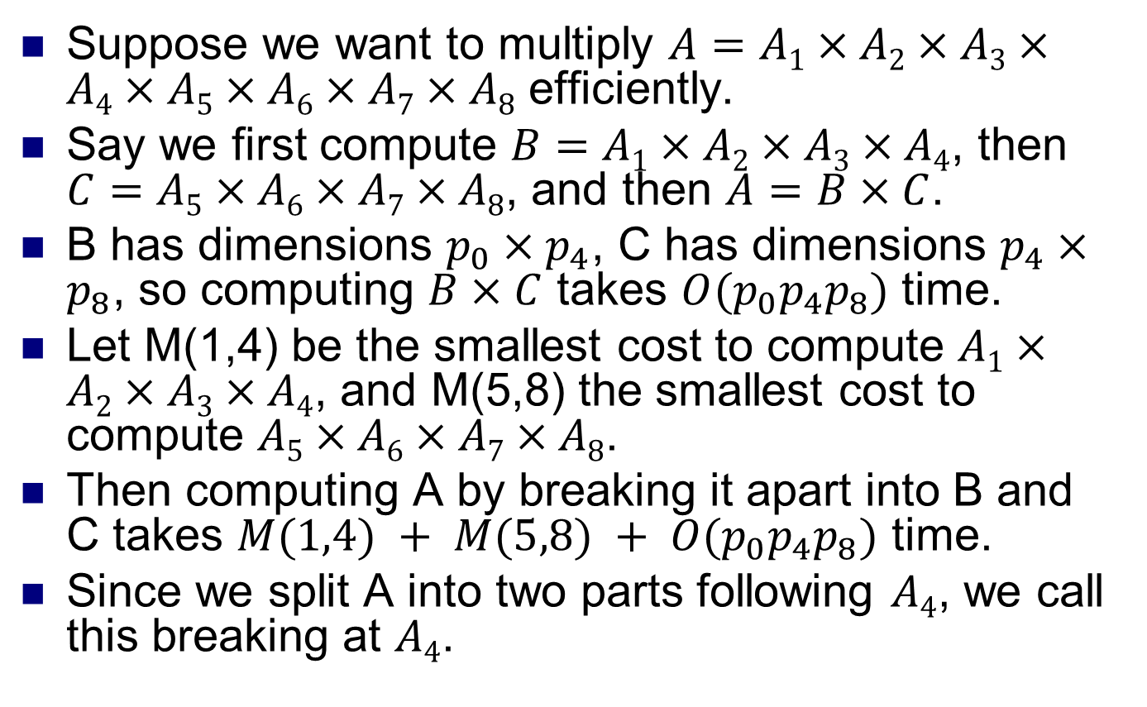
Breaking into subproblems
Suppose we want to multiply $A=A1×A2×A3×A4×A5×A6×A7×A8$ efficiently.
Say we first compute $B=A1×A2×A3×A4$, then $C=A5×A6×A7×A8$, and then $A=B×C$.
B has dimensions $p_{0}×p_{4}$, C has dimensions $p_{4}×p_{8}$, so computing $B×C$ takes $O(p_{0}p_{4}p_{8})$ time.
Let M(1,4) be the smallest cost to compute $A1×A2×A3×A4$, and M(5,8) the smallest cost to compute $A5×A6×A7×A8$.
Then computing A by breaking it apart into B and C takes $M(1,4) + M(5,8) + O(p_{0}p_{4}p_{8})$ time.
Since we split A into two parts following $A4$, we call this breaking at $A4$.

Slide 7
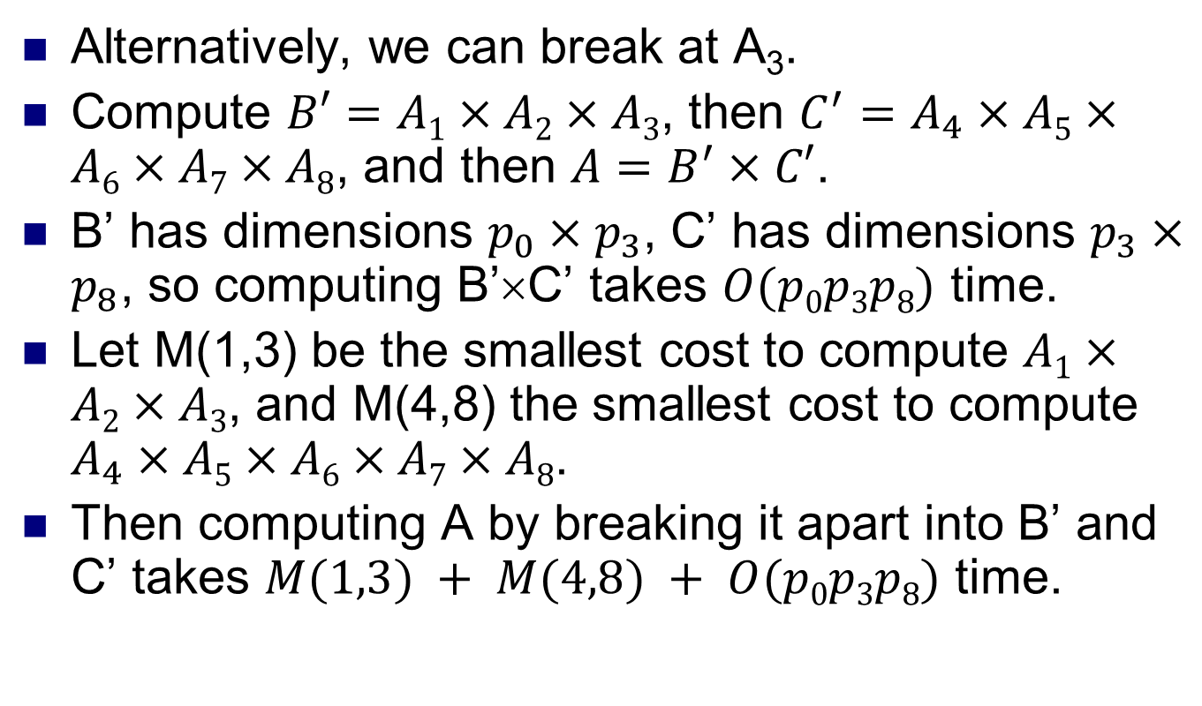
Breaking into subproblems
Alternatively, we can break at A₃.
Compute $B′=A1×A2×A3$, then $C^{′}=A_{4}×A5×A6×A7×A8$, and then $A=B^{′}×C′$.
B’ has dimensions $p_{0}×p_{3}$, C’ has dimensions $p_{3}×p_{8}$, so computing B’×C’ takes $O(p0p3p8)$ time.
Let M(1,3) be the smallest cost to compute $A1×A2×A3$, and M(4,8) the smallest cost to compute $A_{4}×A5×A6×A7×A8$.
Then computing A by breaking it apart into B’ and C’ takes $M(1,3) + M(4,8) + O(p0p3p8)$ time.

Slide 8
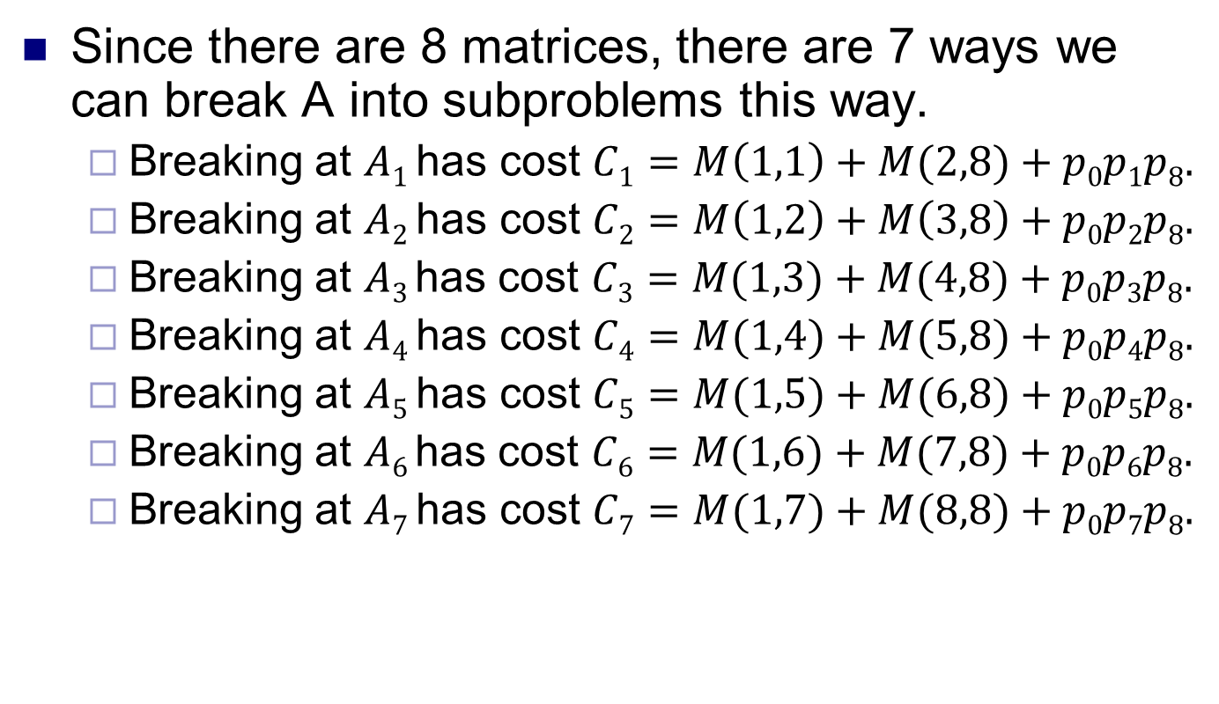
Breaking into subproblems
Since there are 8 matrices, there are 7 ways we can break A into subproblems this way.
Breaking at $A1$ has cost $C1=M\left(1,1\right)+M(2,8)+p0p1p8.$
Breaking at $A2$ has cost $C2=M\left(1,2\right)+M\left(3,8\right)+p0p2p8.$
Breaking at $A3$has cost $C3=M(1,3)+M(4,8)+p0p3p8.$
Breaking at $A4$ has cost $C4=M(1,4)+M(5,8)+p0p4p8.$
Breaking at $A5$ has cost $C5=M(1,5)+M(6,8)+p0p5p8.$
Breaking at $A6$has cost $C6=M(1,6)+M(7,8)+p0p6p8.$
Breaking at $A7$ has cost $C7=M(1,7)+M(8,8)+p0p7p8.$

Slide 9
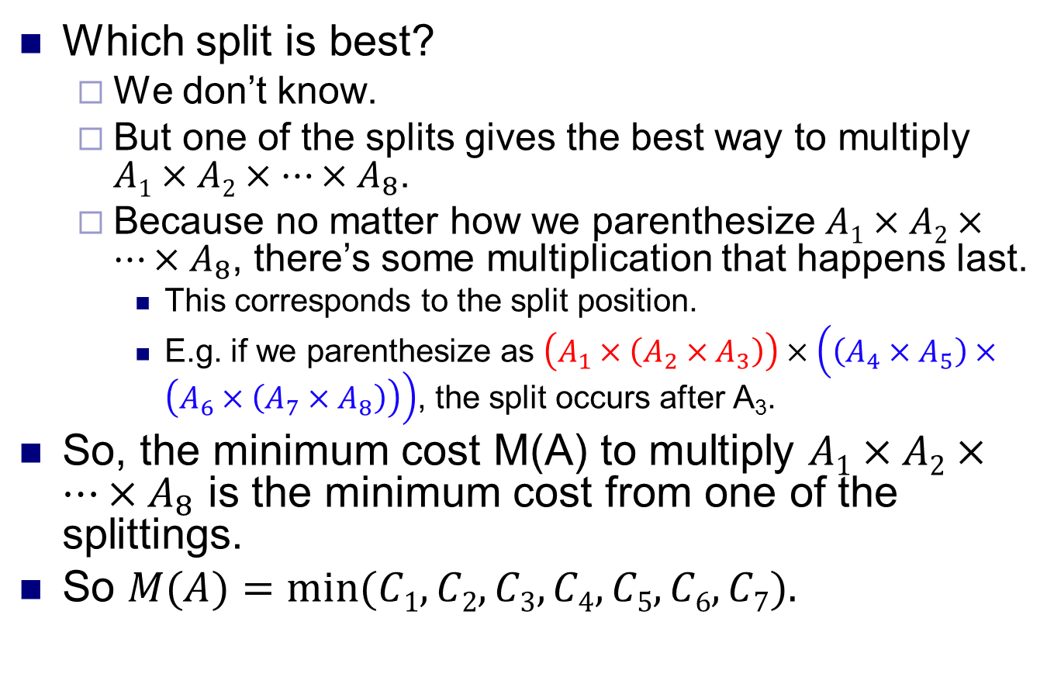
Breaking into subproblems
Which split is best?
We don’t know.
But one of the splits gives the best way to multiply $A1×A2×…×A_{8}$.
Because no matter how we parenthesize $A1×A2×…×A_{8}$, there’s some multiplication that happens last.
This corresponds to the split position.
E.g. if we parenthesize as $\left(A_{1}×\left(A_{2}×A_{3}\right)\right)×\left(\left(A_{4}×A_{5}\right)×\left(A_{6}×\left(A_{7}×A_{8}\right)\right)\right)$, the split occurs after A₃.
So, the minimum cost M(A) to multiply $A1×A2×…×A_{8}$ is the minimum cost from one of the splittings.
So $M(A)=min⁡(C1,C2,C3,C4,C5,C6,C7).$

Slide 10
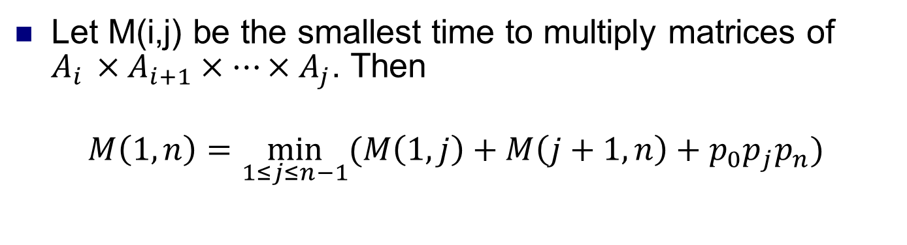
Dynamic programming equation
Let M(i,j) be the smallest time to multiply matrices of $A_{i }×A_{i+1}×…×A_{j}$. Then
$$M\left(1,n\right)=\min_{1≤j≤n−1}{(M\left(1,j\right)+M\left(j+1,n\right)+p_{0}p_{j}p_{n}})$$
Cost of multiplying all the matrices A₁,…,A_{n}.
Choose the best break point j
Cost of the first part
Cost of the second part
Cost of multiplying the matrices produced by the first and second parts

Slide 11
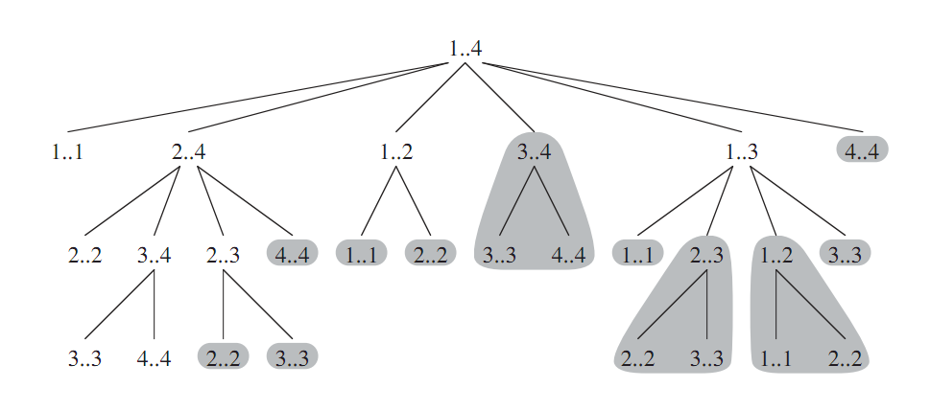
DP equation and subproblems
Solving the main problem M(1,n) requires solving subproblems M(i,j), for 1≤i,j≤n.
Solving each M(i,j) in turn requires solving smaller subproblems.
Work bottom up. Solve smallest subproblems first, then combine the solutions to solutions of bigger subproblems.
In the base case we have M(i,i)=0, for all i.
Because we just have matrix A_{i}, with no multiplications.
Source: Introduction to Algorithms, Cormen et al

Slide 12
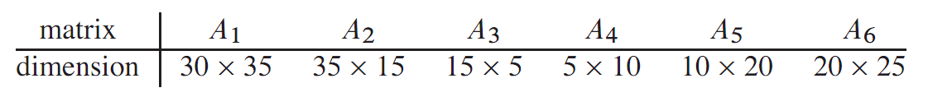
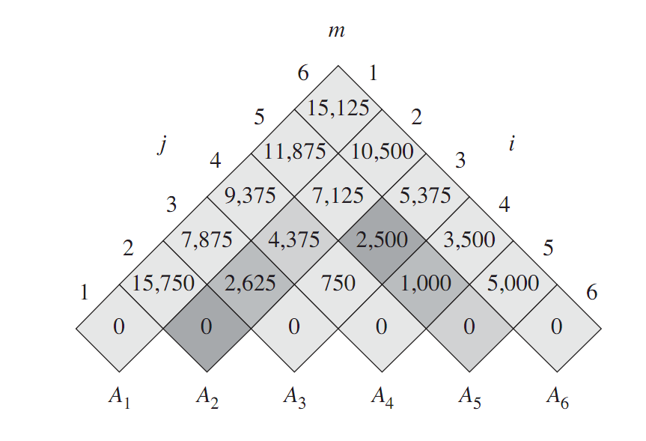
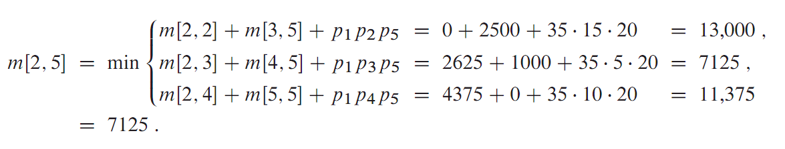
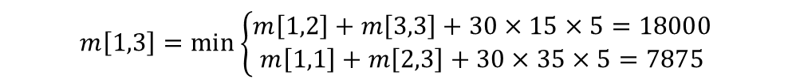
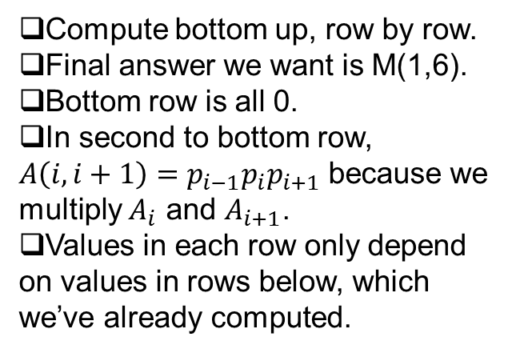
The table method
Compute bottom up, row by row.
Final answer we want is M(1,6).
Bottom row is all 0.
In second to bottom row, $A\left(i,i+1\right)=p_{i−1}p_{i}p_{i+1}$ because we multiply $A_{i}$ and $A_{i+1}$.
Values in each row only depend on values in rows below, which we’ve already computed.
$$m\left[1,3\right]=\min\left\{\begin{aligned}m\left[1,2\right]+m\left[3,3\right]+30×15×5=18000 \\ m\left[1,1\right]+m\left[2,3\right]+30×35×5=7875\end{aligned}\right.$$

Slide 13
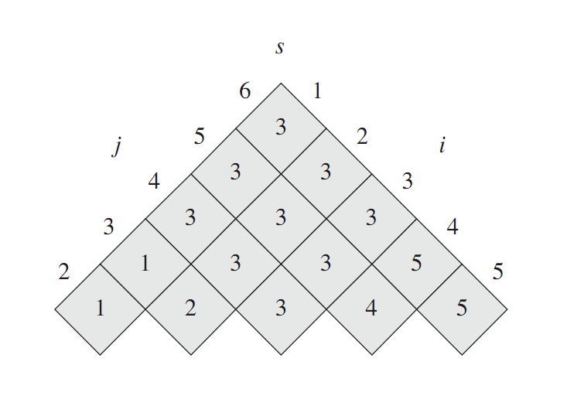
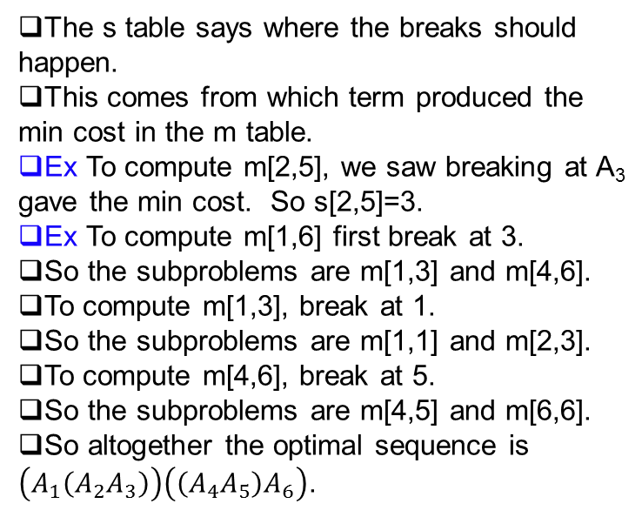
The table method
The s table says where the breaks should happen.
This comes from which term produced the min cost in the m table.
Ex To compute m[2,5], we saw breaking at A₃ gave the min cost. So s[2,5]=3.
Ex To compute m[1,6] first break at 3.
So the subproblems are m[1,3] and m[4,6].
To compute m[1,3], break at 1.
So the subproblems are m[1,1] and m[2,3].
To compute m[4,6], break at 5.
So the subproblems are m[4,5] and m[6,6].
So altogether the optimal sequence is $\left(A_{1}\left(A_{2}A_{3}\right)\right)\left(\left(A_{4}A_{5}\right)A_{6}\right)$.

Slide 14
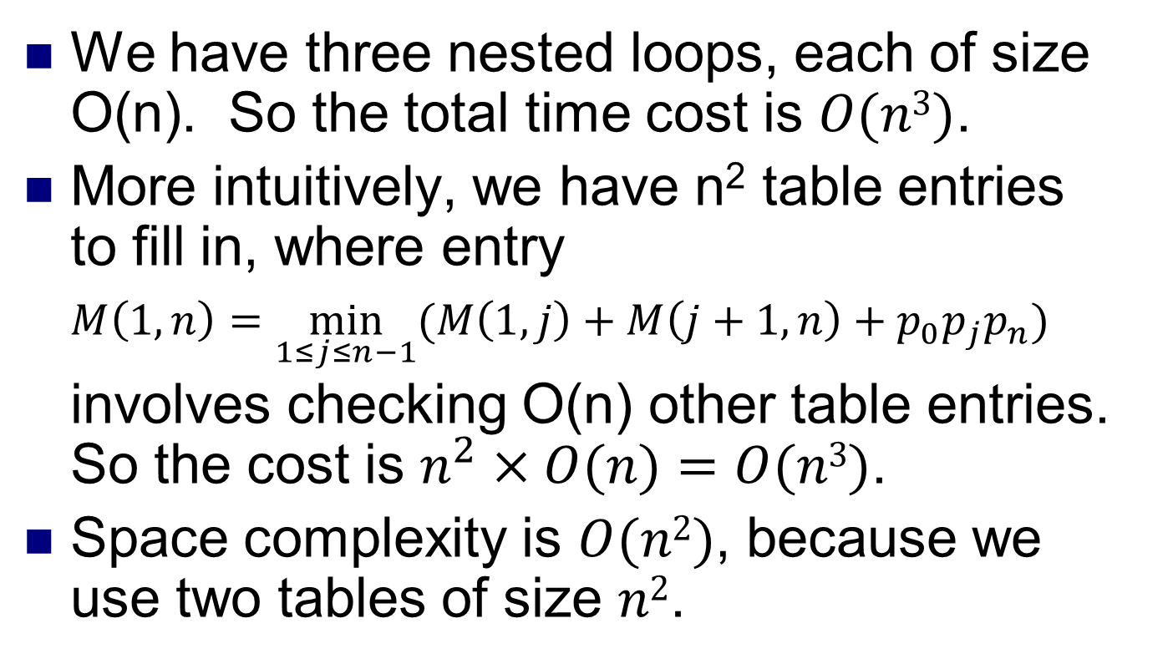
Cost of the table method
We have three nested loops, each of size O(n). So the total time cost is $O(n3)$.
More intuitively, we have n² table entries to fill in, where entry
$M\left(1,n\right)=\min_{1≤j≤n−1}{(M\left(1,j\right)+M\left(j+1,n\right)+p_{0}p_{j}p_{n}})$
involves checking O(n) other table entries. So the cost is $n^{2}×O(n)=O(n3)$.
Space complexity is $O(n2)$, because we use two tables of size $n2$.

Slide 15
Problems without optimal substructure
Can we use dynamic programming to solve all problems efficiently?
No. There are many problems we don’t have any efficient solutions to.
One main reason is, not all problems have the optimal substructure property.
Sometimes, solving a problem optimally involves solving subproblems nonoptimally!
How is this possible?
One main reason is optimal solutions to subproblems might not be combinable to a solution for the original problem.

Slide 16
Problems with(out) optimal substructure
Given a graph, find
The shortest path between two vertices.
The longest simple path between two vertices.
Simple path can’t use a node twice.
Without the restriction, longest path can be infinite. Just go round and round forever.
Not a simple path, cause there’s a cycle, which uses p twice.
p

Slide 17
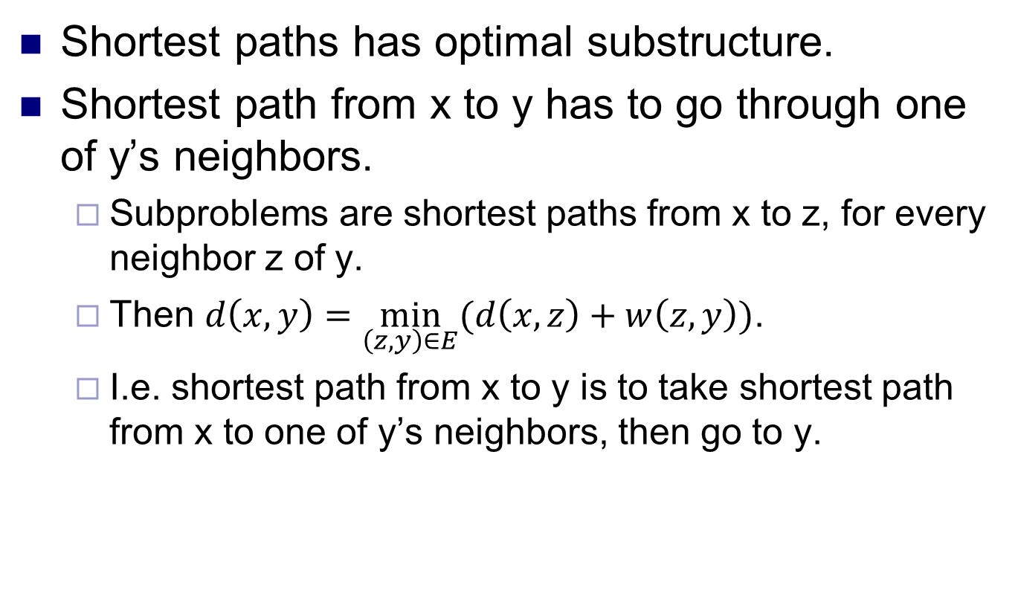
Shortest path
Shortest paths has optimal substructure.
Shortest path from x to y has to go through one of y’s neighbors.
Subproblems are shortest paths from x to z, for every neighbor z of y.
Then $d\left(x,y\right)=\min_{\left(z,y\right)∈E}{(d\left(x,z\right)+w\left(z,y\right))}$.
I.e. shortest path from x to y is to take shortest path from x to one of y’s neighbors, then go to y.

Slide 18
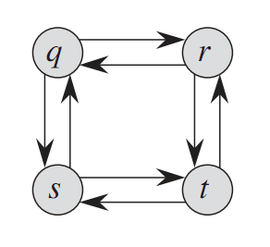
Longest simple path
Longest simple path does not have optimal substructure.
I.e., you can’t get the longest simple paths (LSP) from x to y by piecing together LSP’s from x or y to other nodes.
LSP from q to t is q,r,t.
LSP from q to r is q,s,t,r.
LSP from r to t is r,q,s,t.
But we can’t combine the simple paths from q to r, and from r to t, into another simple path.
When subsolutions aren’t combinable, we say the subproblems aren’t independent.
Not only can’t we solve LSP using dynamic programming, LSP has no known efficient solution.

Slide 19
Longest common subsequence
Given a string X, a subsequence of X is any string formed by removing some letters of X.
Ex “let” is a subsequence of “letters”.
So are “les” and “ees”.
Subsequence isn’t necessarily consecutive.
A common subsequence of strings X and Y is a subsequence of both X and Y.
E.g. “ees” is a common subsequence of both “letters” and “cheers”.
It’s not the longest common subsequence (LCS).
The longest common subsequence (LCS) of “letters” and “cheers” is “eers”.
There may be several LCS’s for some strings.

Slide 20
Application
Given two DNA sequences X and Y, how similar are they? This helps us understand
Will a person get a disease?
Are two people related?
What is the function of a new protein?
One way is to look at the LCS of X and Y.
If the LCS is very long, then X and Y are probably similar.
Many other ways to measure similarity.

Slide 21
Subproblems in LCS
In dynamic programming, we divide a problem into smaller subproblems.
For LCS, we divide the problem on a long string to the problem on a shorter string, by removing the last letter of the long string.
X BDCABA
Y ABCBDA
The last letter of X and Y are both ‘A’. So, ‘A’ is definitely in some LCS of X and Y.
Now, remove ‘A’ from X and Y to get X’ and Y’.
Then the LCS of X and Y, is the LCS of X’ and Y’, appended by ‘A’.
X’ BDCAB
Y’ ABCBD
The last letters of X’ and Y’ don’t match. So these two letters can’t both be in LCS of X and Y.
So either the last letter of X’ isn’t in the LCS, or the last letter of Y’ isn’t in the LCS.
We don’t know which possibility is true, so the DP will try both.
If ‘B’ not in LCS, we remove ‘B’ from X’ to get X’’.
The LCS of X’ and Y’ is the LCS of X’’ and Y’.
X’’ BDCA
Y’ ABCBD
X’ BDCAB
Y’’ ABCB
If ‘D’ not in LCS, we remove ‘D’ from Y’ to get Y’’, and the LCS of X’ and Y’ is the LCS of X’ and Y’’.

Slide 22
A dynamic program for LCS
Let S[1,i] be the first i letters of a string S, and S[i] be the i’th letter of S.
Let S[i,0] be the empty string, for any i.
Let LCS(X[1,i], Y[1,j]) be the LCS of X[1,i] and Y[1,j].
Let c(i,j) be the length of LCS(X[1,i], Y[1,j]).
We have the following dynamic programming equations.
c[i,0] is LCS of X[1,i] and Y[1,0]. Since Y[1,0] is empty string, it has no LCS with X[1,i]. Similarly for c[0,j].
c[i,0] = 0 for all i
c[0,j] = 0 for all j
c[i-1,j-1] + 1 if X[i] = Y[j]
max(c[i-1,j], c[i, j-1]) if X[i] ≠ Y[j]
c[i,j] =
From argument on last slide.

Slide 23
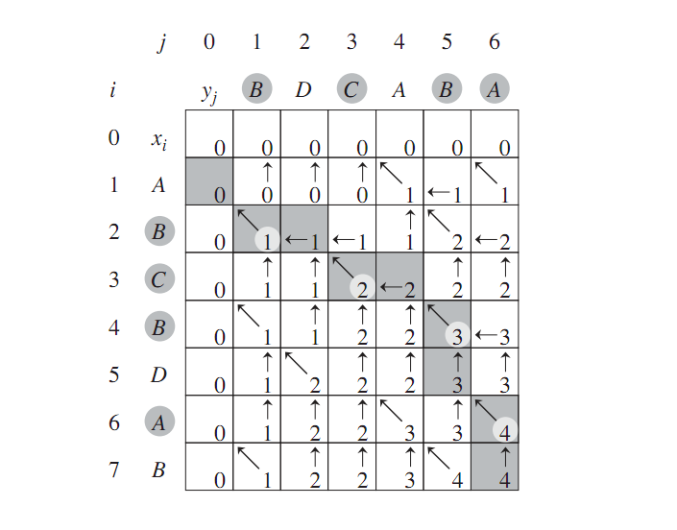
The table method for LCS
c[i,0] = 0 for all i.
c[0,j] = 0 for all j.
Make a table to record the c[i,j] values.
Row is prefixes of Y, column is prefixes of X.
c[i,j] is length of LCS(X[1,i],Y[1,j]).
Start with the 0 column and 0 row. Fill in all 0’s.
Fill in rest of table from left to right, and from top to bottom. I.e. (1,1), (1,2),(1,3),…, (2,1),(2,2),…
Because a cell’s value depends on vals in cells to the left, left-up, and up.
c[i-1,j-1] + 1 if X[i] = Y[j]
max(c[i-1,j], c[i, j-1]) if X[i] ≠ Y[j]
c[i,j] =
Source: Introduction to Algorithms, Cormen et al.

Slide 24
The table method for LCS
c[i,0] = 0 for all i.
c[0,j] = 0 for all j.
If the letters in row i and column j match, val of cell (i,j) = val of cell (i-1,j-1)+1.
Also, make a diagonal arrow, indicating LCS(X[1,i],Y[1,j]) is LCS(X[1,i-1],Y[1,j-1]) plus X[i] (or Y[j]).
If letters don’t match, val of cell (i,j) = max of vals in cells (i-1,j), (i,j-1).
Make an arrow to whichever cell gives has higher val (break ties arbitrarily).
Arrow indicates which way to go to find LCS.
Length of LCS is in bottom right cell (4 in the example).
LCS string given by following arrows starting from bottom right.
Each diagonal arrow corresponds to a matching letter.
The LCS is BCBA in the example.
c[i-1,j-1] + 1 if X[i] = Y[j]
max(c[i-1,j], c[i, j-1]) if X[i] ≠ Y[j]
c[i,j] =

Slide 25
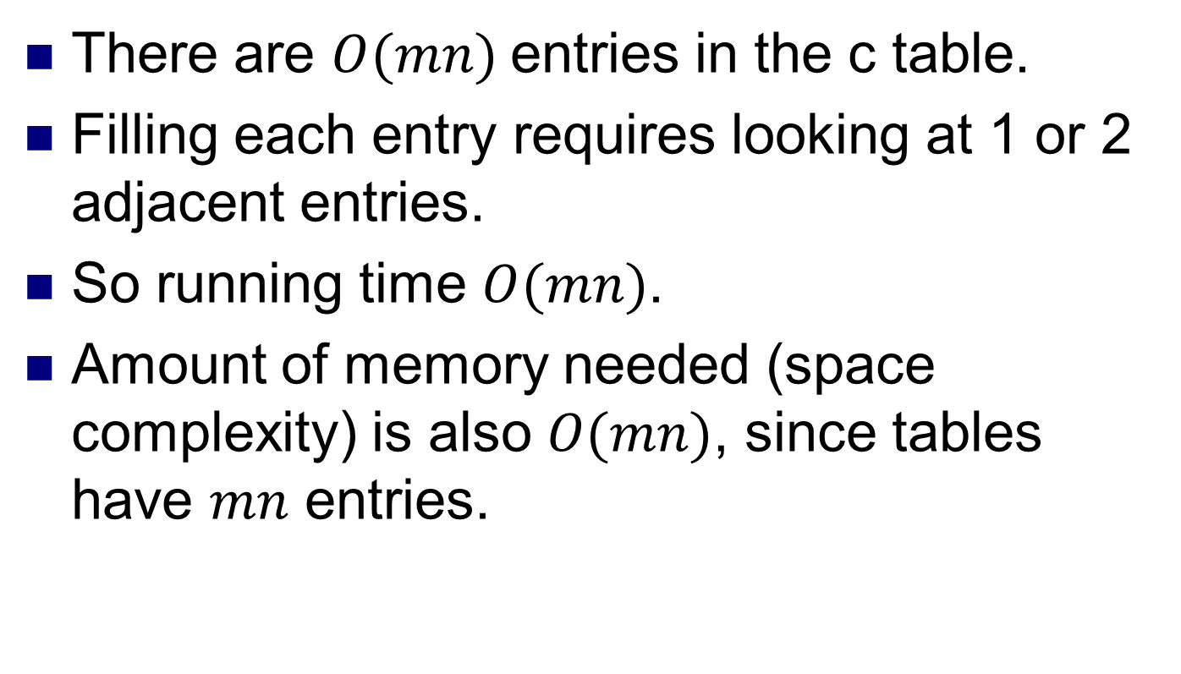
Cost of the LCS DP
There are $O(mn)$entries in the c table.
Filling each entry requires looking at 1 or 2 adjacent entries.
So running time $O(mn)$.
Amount of memory needed (space complexity) is also $O(mn)$, since tables have $mn$ entries.

